Slide 1
Module 2: The DevNet Developer Environment
Instructor Materials
DevNet Associate v1.0
Notes:
Cisco Networking Academy Program
DevNet Associate v1.0
Module 2: The DevNet Developer Environment

Slide 2
Instructor Materials – Module 2 Planning Guide
This PowerPoint deck is divided in two parts:
Instructor Planning Guide
Information to help you become familiar with the module
Teaching aids
Instructor Class Presentation
Optional slides that you can use in the classroom
Begins on slide # 8
Note: Remove the Planning Guide from this presentation before sharing with anyone.
For additional help and resources go to the Instructor Home Page and Course Resources for this course. You also can visit the professional development site on netacad.com, the official Cisco Networking Academy Facebook page, or Instructor Only FB group.
Notes:
2

Slide 3
What to Expect in this Module
To facilitate learning, the following features may be included in this module:
Feature | Description
Hands-On Labs | Labs designed for working with physical equipment.
Module Quizzes | Self-assessments that integrate concepts and skills learned throughout the series of topics presented in the module.
Module Summary | Briefly recaps module content.

Slide 4
Check Your Understanding
Check Your Understanding activities are designed to let students quickly determine if they understand the content and can proceed, or if they need to review.
Check Your Understanding activities do not affect student grades.
There are no separate slides for these activities in the PPT. They are listed in the notes area of the slide that appears before these activities.
Notes:
4

Slide 5
Module 2: Activities
What activity is associated with this module?
Page # | Activity Type | Activity Name | Optional?
2.2.7 | Lab | Explore DevNet Resources | Recommended
Notes:
5

Slide 6
Module 2: Best Practices
Prior to teaching Module 2, the instructor should:
Review the activities and assessments for this module.
Try to include as many questions as possible to keep students engaged during classroom presentation.
Topic 2.1
Provide an overview of DevNet.
Ask the learners if they have heard of the term “sandbox”? Ask them to share their understanding of the term, if any.
Reinforce the fact that this course contains all resources that may be required by the learners to obtain the skills on DevNet.
Notes:
6

Slide 7
Module 2: Best Practices (Contd.)
Topic 2.2
Visit the DevNet Home page at developer.cisco.com and showcase the DevNet online resources to the class.
Explain that a part of the certification includes understanding the large number of online resources available for Cisco products.
Introduce DevNet Learning Labs, DevNet Sandbox, and DevNet Exchanges with examples. Discuss how to find a use case in Automation Exchange.
Visit the developer.cisco.com/support website and explain the elements on the DevNet Developer Support Home page such as Knowledge Base, Support Case, Forum Community and Chat with DevNet.
Notes:
7

Slide 8
Module 2: The DevNet Developer Environment
DevNet Associate v1.0
Notes:
Cisco Networking Academy Program
DevNet Associate v1.0
Module 2: The DevNet Developer Environment
In-Session Activities / Explanations:
Time: 5 min
Instructor Notes:
Welcome the audience in a warm and cordial manner. Ensure that everyone is set up with the required resources.
Introduce the topic and encourage learners to come up with a list of expectations from the session. Collate topics on the white board or Desktop while using learner’s inputs to interpret them in words.
Read out the Objectives and briefly describe each.
Key Points: NA

Slide 9
Module Objectives
Module Title: The DevNet Developer Environment
Module Objective: Implement a development environment using DevNet resources.
Topic Title | Topic Objective
DevNet Overview | Explain how DevNet encourages communities of network programmers.
Exploring DevNet Online Resources | Investigate DevNet online resources.
Notes:
9
2 – The DevNet Developer Environment
2.0.2 – What Will I Learn to Do in this Module?

Slide 10
2.1 DevNet Overview
Notes:
Source:
2 – The DevNet Developer Environment
2.1 – DevNet Overview
In-Session Activities / Explanations:
Time: 5 min
Instructor Notes:
Start by providing an overview of DevNet and its different features.
By the end of the topic, mention that each of the topics will be covered in detail.
Ask them to visit the DevNet Website and explore the features before starting the next topic.
Key Points: DevNet and its features

Slide 11
The DevNet Developer Environment What is DevNet?
DevNet is a fully-integrated developer program comprising a website, an interactive developer community, coordinated developer tools, integrated discussion forums, and sandboxes. It consists of the following features:
Learning Labs - Self-paced tutorials that covers topics from basic coding to using REST APIs with various technologies
Sandboxes - Production-like development and testing environments for a host of technologies
Code Exchange - A repository of sample code written by other developers
Developer support - Support for developer related issues through tickets, live chats, and forums
Developer documentation - A central location for all of the product developer API documentation
Notes:
2 – The DevNet Developer Environment
2.1 – DevNet Overview
2.1.1 – What is DevNet?

Slide 12
2.2 Exploring DevNet Online Resources
Notes:
Source:
2 – The DevNet Developer Environment
2.2 – Exploring DevNet Online Resources
In-Session Activities / Explanations:
Time: 10 min
Instructor Notes:
Start by visiting the DevNet Website (developer.cisco.com) and explain the different DevNet Resources on the Home Page.
Emphasize on the offerings of DevNet Learning Lab and explain its importance in the training program.
Display the various sandboxes on the Website and provide an insight on each of the sandboxes.
Describe DevNet Exchanges and its types by using different examples.
By the end of the topic, inquire how the learners performed during the Learning Lab.
Key Points: DevNet Resources, DevNet Learning Labs, DevNet Exchanges, Use case in Automation Exchange, DevNet Sandbox, DevNet Support

Slide 13
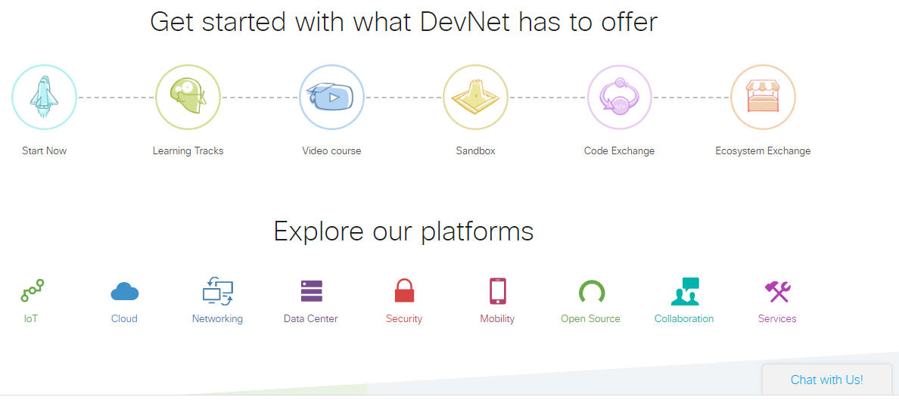
Exploring DevNet Online Resources Getting Started with DevNet Resources
DevNet provides developers a starting point for all Cisco APIs, including API documentation, education, and developer support.
To get an overview of DevNet, visit the DevNet Home page at developer.cisco.com
The site offers the following:
Start Now
Learning Tracks
Video Course
Sandbox
Code Exchange
Ecosystem Exchange
Notes:
2 - The DevNet Developer Environment
2.2 - Exploring DevNet Online Resources
2.2.1 - Getting Started with DevNet Resources

Slide 14
Exploring DevNet Online Resources DevNet Learning Labs
DevNet Learning Labs provide:
Tutorials – Cover engineering technologies, programming languages, and concepts such as model-driven programmability, REST APIs, Python, and JavaScript.
A walk-through for using a DevNet Sandbox - A pre-configured environment that is already installed with Cisco platforms.
DevNet Learning Labs also enables you to:
Set up a development environment - For practicing tasks on a local computer
Mimic the overall DevNet site - Using tutorials on coding, collaboration, IoT, data centre, mobility (mobile and wireless), and networking.
Notes:
2 - The DevNet Developer Environment
2.2 - Exploring DevNet Online Resources
2.2.2 - DevNet Learning Labs

Slide 15
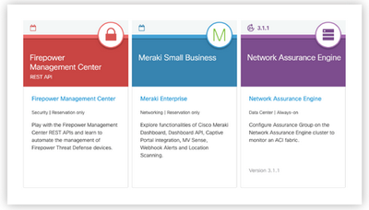
Exploring DevNet Online Resources DevNet Sandbox
DevNet offers a host of sandboxes that enables hands-on exploration of software and APIs.
Notes:
2 - The DevNet Developer Environment
2.2 - Exploring DevNet Online Resources
2.2.3 - DevNet Sandbox

Slide 16
Exploring DevNet Online Resources DevNet Exchanges
DevNet provides multiple ways for community members to share with each other. These are called Exchanges.
Currently, the following exchanges are available:
Automation Exchange – This exchange provides a collection of network automation use cases with different solutions and toolkits.
Code Exchange – This exchange is a repository of source code or tools. It uses the GitHub API, as well as human moderators, to categorize and display hundreds of related repositories.
Ecosystem Exchange – In this exchange, one can find over 1,500 solutions across different technologies, industries, and geographies to begin solution design and development.
Notes:
2 - The DevNet Developer Environment
2.2 - Exploring DevNet Online Resources
2.2.4 - DevNet Exchanges

Slide 17
Exploring DevNet Online Resources Find a Use Case in Automation Exchange
The Automation Exchange provides various use cases for network automation that include:
Listing of data
Adding configurations
Activating policies across domains, users, or devices
The listings are for different tool sets such as Ansible or Puppet, and different infrastructure scenarios, such as:
Campus or Branch
Data Centre
Service Provider
Notes:
2 - The DevNet Developer Environment
2.2 - Exploring DevNet Online Resources
2.2.5 – Find a Use Case in Automation Exchange

Slide 18
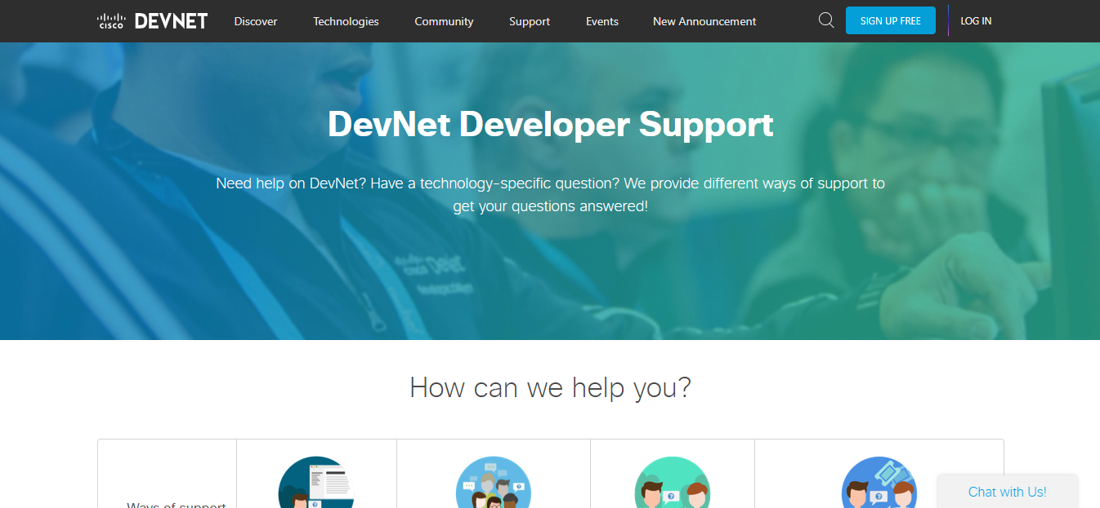
Exploring DevNet Online Resources DevNet Developer Support
DevNet offers developer support and can help troubleshoot integrations, API connections, and other specialty questions about developer use cases on Cisco products.
Visit the website developer.cisco.com/support for more information.
One can get support by:
Logging a ticket
Posting to a community forum
Accessing a WebEx Teams space
Notes:
2 - The DevNet Developer Environment
2.2 - Exploring DevNet Online Resources
2.2.6 – DevNet Developer Support

Slide 19
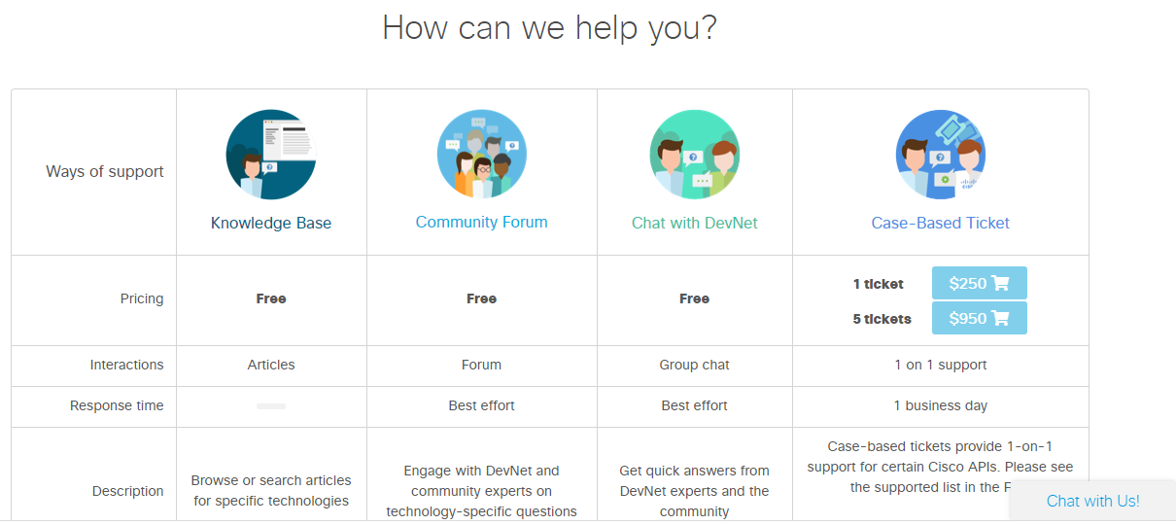
Exploring DevNet Online Resources DevNet Developer Support (Contd.)
Knowledge Base - Consists of troubleshooting articles for reference.
Support Case - A case-based ticket used for one-on-one support with a response time of one business day.
Forums in the Cisco Developer Community - To view community forums, visit https://devnetsupport.cisco.com and click Community.
Notes:
2 - The DevNet Developer Environment
2.2 - Exploring DevNet Online Resources
2.2.6 – DevNet Developer Support

Slide 20
Exploring DevNet Online Resources Lab – Explore DevNet Resources
In this lab, you will complete the following objectives:
Part 1: Find and Navigate a Learning Lab
Part 2: Explore More Resources
Notes:
2 - The DevNet Developer Environment
2.2 - Exploring DevNet Online Resources
2.2.7 – Lab - Explore DevNet Resources

Slide 21
2.3 DevNet Developer Environment Summary
Notes:
2 - The DevNet Developer Environment
2.3 - DevNet Developer Environment Summary
In-Session Activities / Explanations:
Time: 5 mins
Instructor Notes:
Read out the summary points mentioned on the slide.
Discuss the same with the participants.
Ask if they have any questions or doubts.
Key Points: DevNet Developer Environment Summary

Slide 22
DevNet Developer Environment Summary What did I learn in this module?
DevNet provides developers with a starting point for all Cisco APIs.
Online Resources include DevNet Learning Labs, DevNet video courses, DevNet Sandbox, DevNet Exchanges, and extensive DevNet Support.
Notes:
2 - The DevNet Developer Environment
2.3 - DevNet Developer Environment Summary
2.3.1 - What did I learn in this module?
2.3.2 - Module 2: The DevNet Developer Environment Quiz

Slide 23
Module 2 New Terms and Commands
DevNet Sandbox Learning Labs Ansible Puppet | Code Exchange Automation Exchange Ecosystem Exchange REST APIs
Notes:
2 - The DevNet Developer Environment
New Terms and Commands

